Slide 1
Kubernetes 存储详解
邓德源

Slide 2
Kubernetes 概要
Kubernetes 存储模型和概念
Kubernetes 存储新功能介绍

Slide 3
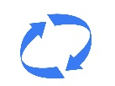
Kubernetes Overview - API
API Objects
System Abstraction
Desired state of world: Specification
Actual/Current state of world: Status
Object Kind
Pod, Service, Namespace, Volume, etc
Object Operation
CRUD
Watch
apiVersion: v1
kind: Node
metadata:
labels:
beta.kubernetes.io/arch: amd64
beta.kubernetes.io/os: linux
kubernetes.io/hostname: minikube
name: minikube
resourceVersion: "1027609"
selfLink: /api/v1/nodesminikube
uid: 21ffcb42-0f69-11e7-a9ff-080027e561ba
spec:
externalID: minikube
status:
addresses:
- address: 192.168.99.101
type: LegacyHostIP
- address: 192.168.99.101
type: InternalIP
- address: minikube
type: Hostname
Who maintains the states?

Slide 4
Kubernetes Overview - Design Principles
Declarative -> imperative: State your desired result, let the system actuate
e.g. I (user) want a persistent volume with size 10G backed by Ceph
Control loops: Observe, Rectify, Repeat
e.g. Ack! I (controller) will find a volume with at least 10G from Ceph, and if failed, will create one for you
Simple > Complex: Try to do as little as possible
e.g. I will find a volume from Ceph for you, but I do not know how to attach it; it’s someone else’s problem
Modularity: Components, interfaces & plugin
e.g. I provision Ceph volume based on kubernetes interface. There is also a GluserFS plugin to provision GluserFS.
Legacy Compatible: Meet users where they are, requiring apps to change is a non-starter
e.g. Upgrading kubernetes cluster doesn’t require user to update application
Open > Closed: Open Source, Standards, JSON, REST, etc
Eric Raymond’s 17 Unix Rules

Slide 5
Kubernetes Storage System - Overview
Kubernetes Storage System Responsibility
Make storage available for workloads
Independent of scheduling, workload lifecycle, etc
Easy access via directory
Automatically
Bind/Provision, Attach/Detach, Mount/Unmount
Enforce reclaim policy: recycle, delete, etc
Support multiple types of volumes
Persistent, Ephemeral, Local storage, Network attached, etc
Support multiple types of usage patterns
Direct Access, Static Provisioning, Dynamic Provisioning, etc

Slide 6
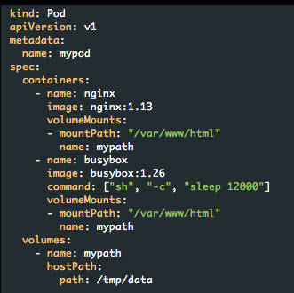
Kubernetes Storage System - Overview
Core Concepts
Volume: source of storage
Persistent, Ephemeral, Local, Network attached, etc
VolumeMounts:
Where to mount the volume in the container
A single volume can be mounted into multiple containers
Surrounding concepts built for more use cases
Persistent volume
Persistent volume claim
StorageClass
All we’ll talk about below is how to represent “Volume”.

Slide 7

Kubernetes Storage System - Overview
Persistent (Networked)
GCE Persistent Disk
AWS Elastic Block Store
Azure File Storage
Azure Data Disk
iSCSI
Flocker
NFS
vSphere
GlusterFS
Ceph File and RBD
Cinder
Quobyte Volume
FibreChannel
VMWare Photon PD
Portworx
Dell EMC ScaleIO
Ephemeral (Local)
Empty dir (and tmpfs)
Expose K8s API
Secret
ConfigMap
DownwardAPI
Other
Flex (exec a binary)
Host path
New
Local Persistent Storage
Data Source: Google

Slide 8
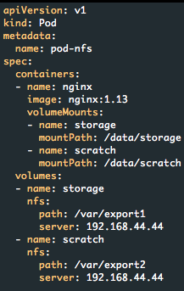
Kubernetes Storage System - Direct Access
Directly write volume details in Pod configuration
Same approach for all kinds of volumes, i.e. persistent, local, ephemeral, etc
Host Path
NFS

Slide 9
Kubernetes Storage System - Direct Access
Direct Access Workflow
Pod
kubelet
apiserver
kubelet
scheduler
controller
kubelet

Slide 10
Kubernetes Storage System - Direct Access
Directly assign to a Node.
kubelet
apiserver
kubelet
scheduler
controller
kubelet

Slide 11
Kubernetes Storage System - Direct Access
Call plugin to attach/mount volume.
kubelet
apiserver
kubelet
scheduler
controller
kubelet

Slide 12
Kubernetes Storage System - Direct Access
Call plugin to attach/mount volume
kubelet

Slide 13
Kubernetes Storage System - Direct Access
These are my in-tree plugins.
kubelet
hostPath
glusterfs
gce
nfs
……

Slide 14
Kubernetes Storage System - Direct Access
kubelet
hostPath
glusterfs
gce
nfs
……
Pod

Slide 15
Kubernetes Storage System - Direct Access
kubelet
hostPath
glusterfs
gce
nfs
……
Pod

Slide 16
Kubernetes Storage System - Direct Access
The END.
Observation:
Pod is created and scheduled on a Node
scheduling is independent of volume
Kubelet has built-in plugin libraries
one for each supported volume type
Two existing NFS volumes are attached to Pod
no provisioning
no configuration knob
More
kubelet

Slide 17
Kubernetes Storage System - Issues with DA
Right now, we know how kubernetes volume works, and that’s really the most basic and fundamental part!
But what’s the issues?
Not portable
Direct access is not portable at all - need to change pod spec when changing environment
There is no way to share volume configuration without having to give pod configuration, which is a separate thing
Not secure
Storage information is exposed to user, e.g. NFS’s server IP address
Or even worse, secret information
Not flexible
All possible configurations are hard-coded in Pod spec

Slide 18
Kubernetes Storage System – Issues with DA
Not scalable
Need coordination between admins and users, as well as between users and users
Storage information must be distributed to all requesting users
Probably more
All problems in computer science can be solved by another level of indirection

Slide 19
Kubernetes Storage System – Issues with DA
Root problem with direct access
Tight coupling between setting up storage and request/use storage
Solution
Add another layer which separate the complexity: admin sets up storage, user requests storage
Cluster Admin
Pod
User
Image Source: Google

Slide 20
Kubernetes Storage System - PV and PVC
Admin <- PersistentVolume (PV)
Persistent volume represents a schedulable, requestable storage identity
Can be networked storage, local storage, etc
User <- PersistentVolumeClaim (PVC)
Claim volumes of specific size and modes
PersistentVolumes (PV)
Cluster Admin
PVClaim
User
Image Source: Google

Slide 21
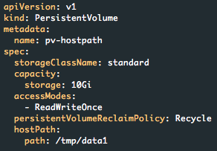
Kubernetes Storage System - PV and PVC
Admin <- PersistentVolume (PV)
Persistent volume represents a schedulable, requestable storage identity
Can be networked storage, local storage, etc
Size of this volume. This is a binding option.
Kubernetes will NOT enforce size limit! It’s the responsibility of underline storage solution!

Slide 22
Kubernetes Storage System - PV and PVC
Admin <- PersistentVolume (PV)
Persistent volume represents a schedulable, requestable storage identity
Can be networked storage, local storage, etc
Access mode of the volume. Again, this is a binding option.
- RWO, the volume can be mounted as read-write by a single node
- ROX, the volume can be mounted as read-only by many nodes
- RWX, the volume can be mounted as read-write by many nodes
Kubernetes will NOT enforce access mode specified in PV specification.

Slide 23
Kubernetes Storage System - PV and PVC
Admin <- PersistentVolume (PV)
Persistent volume represents a schedulable, requestable storage identity
Can be networked storage, local storage, etc
What happens if the volume is released, i.e. when a claim is deleted.
- Retain, manual reclamation
- Recycle, basic scrub (rm -rf /thevolume/*) DEPRECATED
- Delete, delete associated storage asset, e.g. glusterfs volume

Slide 24
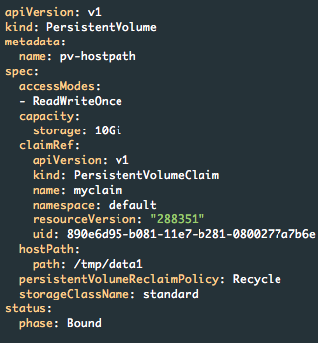
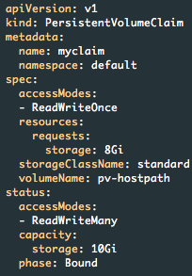
Kubernetes Storage System - PV and PVC
User <- PersistentVolumeClaim (PVC)
Claim volumes of specific size and modes

Slide 25
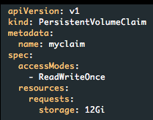
Kubernetes Storage System - PV and PVC
User <- PersistentVolumeClaim (PVC)
Question
PV size smaller than requested

Slide 26
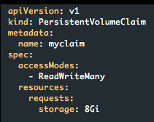
Kubernetes Storage System - PV and PVC
User <- PersistentVolumeClaim (PVC)
Question
PV access mode doesn’t match

Slide 27
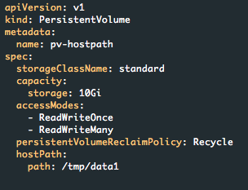
Kubernetes Storage System - PV and PVC
User <- PersistentVolumeClaim (PVC)
Question

Slide 28
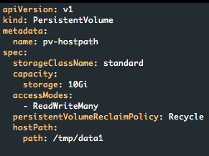
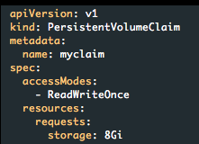
Kubernetes Storage System - PV and PVC
User <- PersistentVolumeClaim (PVC)
Question
PV access mode doesn’t match (even if RWO < RWX, admin should add RWO to PV)

Slide 29
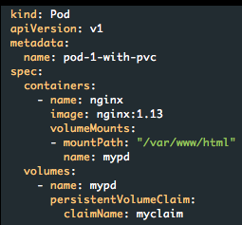
Kubernetes Storage System - PV and PVC
User <- Pod with PVC
Pod using PVC via the same Volume concept we learned before
User doesn’t care about PV or underline storage anymore - it is abstracted away

Slide 30
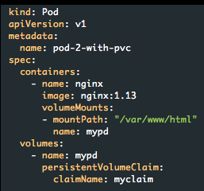
Kubernetes Storage System - PV and PVC
Question: two pods using one RWO?
User <- Pod with PVC

Slide 31

Kubernetes Storage System - PV and PVC
User <- Pod with PVC
Lucky case!
Bad case!
Not yet decided how to handle this. Lack the ability to say a RWO PV can only mount to a single node but can be mounted via multiple Pods.

Slide 32
Kubernetes Storage System - PV and PVC
PV & PVC workflow
PV
kubelet
apiserver
kubelet
scheduler
admin
controller
kubelet

Slide 33
Kubernetes Storage System - PV and PVC
Save it for future usage
kubelet
apiserver
kubelet
scheduler
admin
controller
kubelet

Slide 34
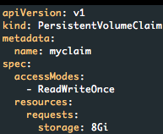
Kubernetes Storage System - PV and PVC
PVC
kubelet
apiserver
kubelet
scheduler
user
controller
kubelet

Slide 35
Kubernetes Storage System - PV and PVC
Save and bind PV/PVC
kubelet
apiserver
kubelet
scheduler
user
controller
kubelet

Slide 36
Kubernetes Storage System - PV and PVC
Pod
kubelet
apiserver
kubelet
scheduler
user
controller
kubelet

Slide 37
Kubernetes Storage System - PV and PVC
Fetch PVC and PV, then follow the same steps as Volume
kubelet
apiserver
kubelet
scheduler
user
controller
kubelet

Slide 38
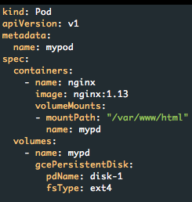
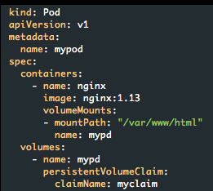
Kubernetes Storage System - PV and PVC
Problem solved?
Not portable
Not secure
Not flexible
Not scalable
Not flexible and scalable

Slide 39
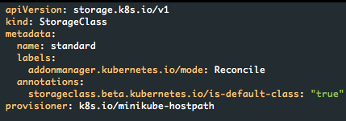
Kubernetes Storage System - StorageClass
StorageClass is an API object created by admin to enable dynamic provisioning
Create PersistentVolume on request
Allow more configuration parameters

Slide 40
Kubernetes Storage System - StorageClass
Create PersistentVolume on request
StorageClass
kubelet
apiserver
kubelet
scheduler
admin
controller
kubelet

Slide 41
Kubernetes Storage System - StorageClass
Save it for future usage
kubelet
apiserver
kubelet
scheduler
admin
controller
kubelet

Slide 42
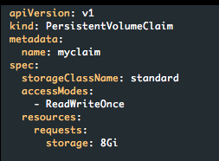
Kubernetes Storage System - StorageClass
PVC
kubelet
apiserver
kubelet
scheduler
user
controller
kubelet

Slide 43
Kubernetes Storage System - StorageClass
Save it for future usage
kubelet
apiserver
kubelet
scheduler
user
controller
kubelet

Slide 44
Kubernetes Storage System - StorageClass
Future is coming!
In-tree Provisioner
or
External Provisioner
kubelet
apiserver
kubelet
scheduler
user
controller
kubelet

Slide 45
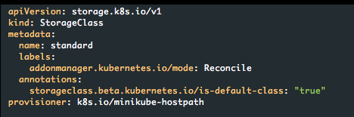
Kubernetes Storage System - StorageClass
Future is coming!
Watch All new Claims, for each one, find its StorageClass based on spec.storageClassName, then provision new PV if class.provisioner match my name.

Slide 46
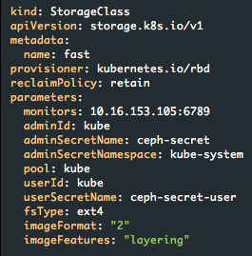
Kubernetes Storage System - StorageClass
Allow more configuration parameters
More options can be added to StorageClass. For example, ”reclaimPolicy”, plugin specific options in “parameters”.

Slide 47
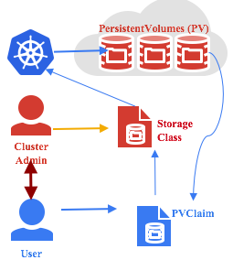
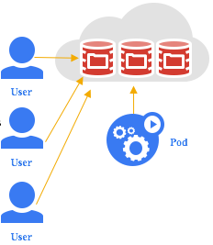
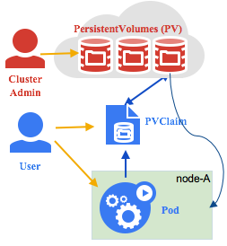
Kubernetes Storage System - StorageClass
Evolution Path
Image Source: Google

Slide 48
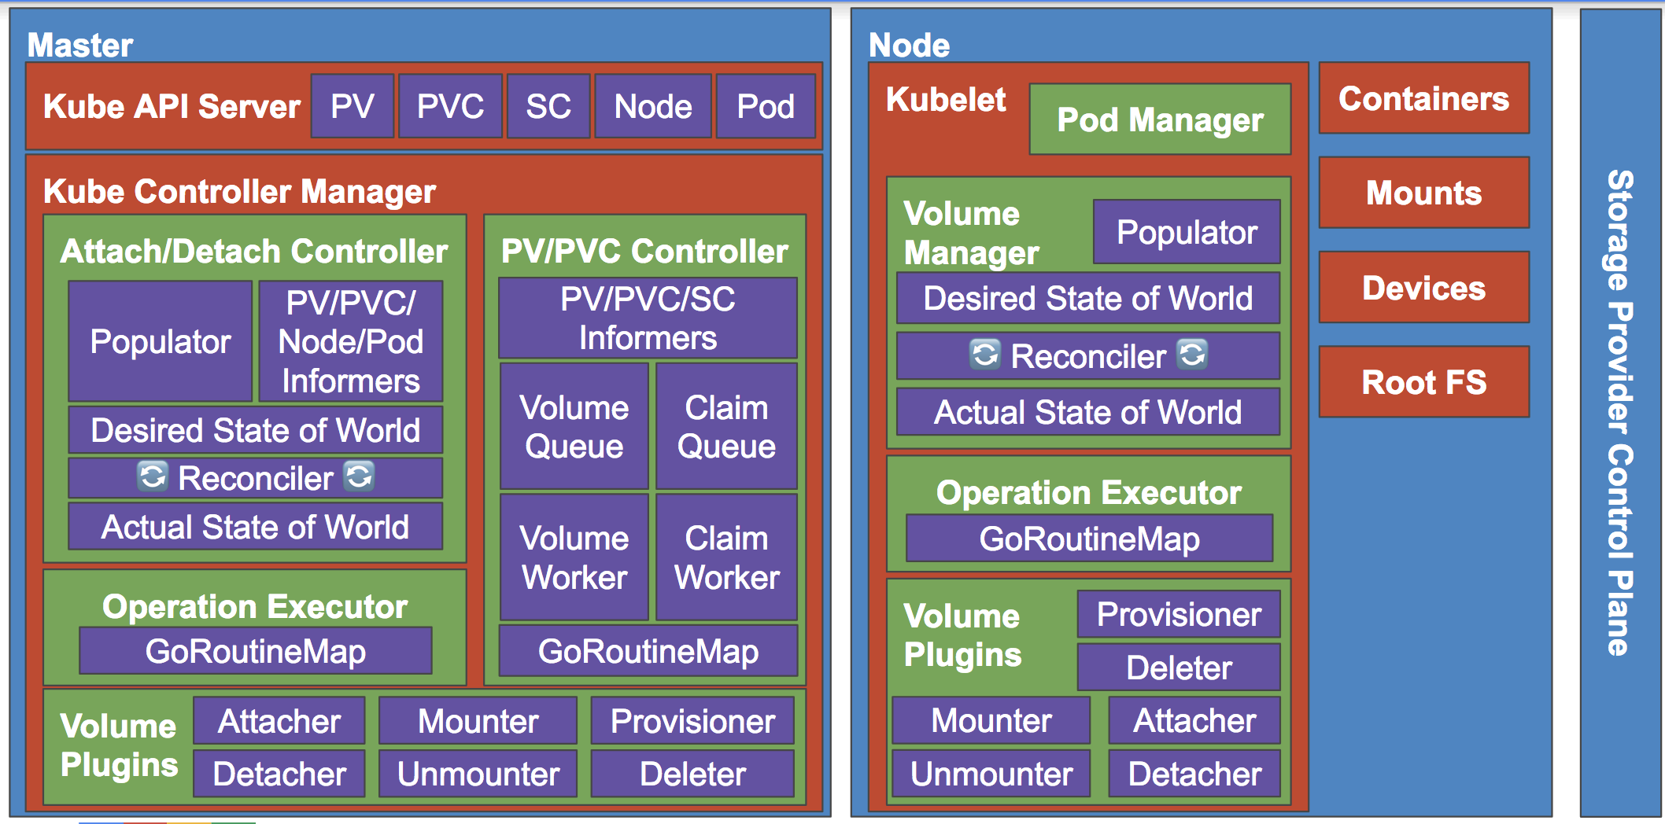
Kubernetes Storage System - Internals
Image Source: Google

Slide 49
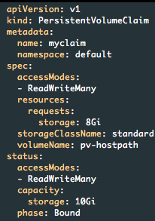
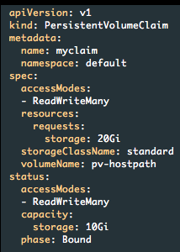
Kubernetes New Features - Volume Resize
Goal
Allow users to expand PersistentVolume
Use case
My data volume is full, I want to expand the volume without 1. losing data; 2. taking my application offline

Slide 50
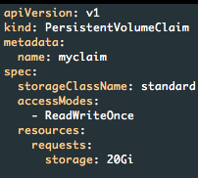
Kubernetes New Features - Volume Resize
Expand PersistentVolume Workflow
Update PVC
kubelet
apiserver
kubelet
scheduler
user
controller
kubelet

Slide 51
Kubernetes New Features - Volume Resize
kubelet
apiserver
kubelet
scheduler
user
controller
kubelet
A resize is requested, mark resize started.

Slide 52
Kubernetes New Features - Volume Resize
Controller imports the same set of libraries seen in kubelet to expand underline storage.
apiserver
scheduler
controller
hostPath
glusterfs
gce
ceph
……

Slide 53
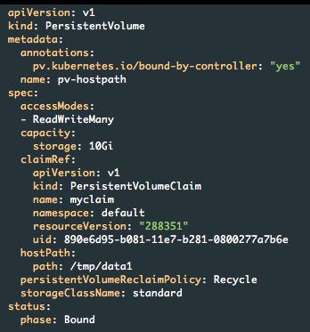
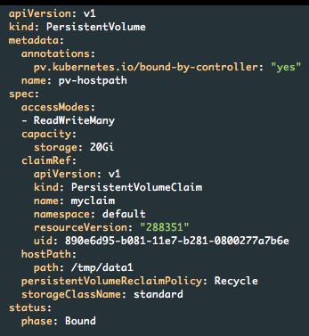
Kubernetes New Features - Volume Resize
apiserver
scheduler
user
controller
Successfully expanded underline storage! Now we have resized volume!!

Slide 54
Kubernetes New Features - Volume Resize
Not yet! I need to resize filesystem if pv.spec.capacity > pvc.status.capacity
kubelet
apiserver
kubelet
scheduler
user
controller
kubelet

Slide 55
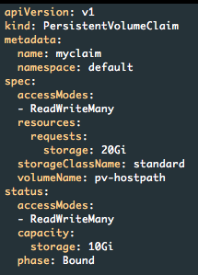
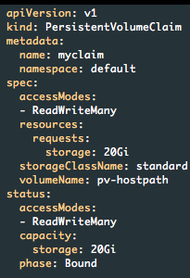
Kubernetes New Features - Volume Resize
kubelet
user
Update PVC for new capacity, which is the final capacity!

Slide 56
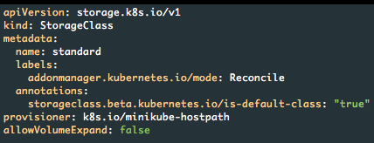
Kubernetes New Features - Volume Resize
A lot of corner cases
Update size is larger than allowed quota
Bound size is already larger than updated size
Multiple size update for the same persistent volume
Underline storage doesn’t support resize
Underline storage doesn’t need filesystem resize
Interaction with PV binding controller, attach/detach controller, etc
Failure can occur at any time
Most importantly, security

Slide 57
Kubernetes New Features - Local Volume
Two different topics
Local ephemeral storage
Focus on container overlay storage, pod emptyDir storage management
Local persistent storage
Focus on representation of local disk, SSD, etc

Slide 58
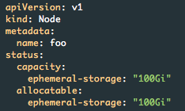
Kubernetes New Features - Local Volume
Local ephemeral storage
Container overlay - limit usage just as CPU and memory
EmptyDir - limit size of scratch space
Kubelet exposes ephemeral-storage in Node object. Exact number comes from kubelet root directory.

Slide 59
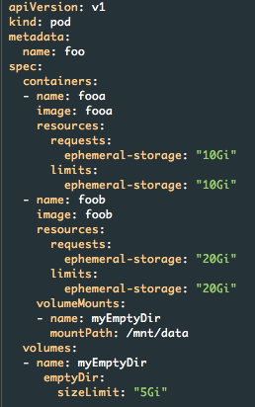
Kubernetes New Features - Local Volume
Local ephemeral storage
Container overlay - limit usage just as CPU and memory
EmptyDir - limit size of scratch space
Pod requests resource similar to CPU and Memory.
Kubelet will do a soft limit - evict pod who exceeds requested resource (no cgroup, no fs quota)

Slide 60
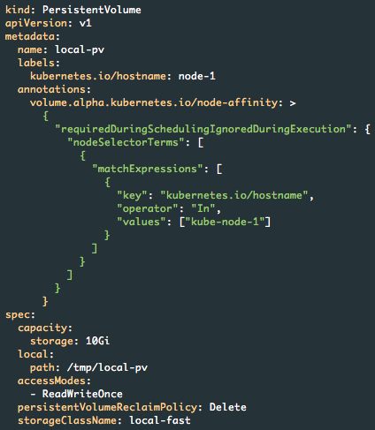
Kubernetes New Features - Local Volume
Local persistent storage
Represent local persistent volume

Slide 61
Kubernetes New Features - Local Volume
Compare to hostPath
hostPath requires admin to manually manage volume lifecycle
local volume leverage existing PV/PVC mechanism
hostPath requires coordination between user and admin
this is the exact problem solved by PV/PVC/StorageClass
hostPath requires manual scheduling; otherwise pod can schedule to different node
local volume uses affinity feature already in kubernetes to keep locality
hostPath requires manual setup for directory permission, ownership, isolation, etc
these options are included in local volume configuration

Slide 62
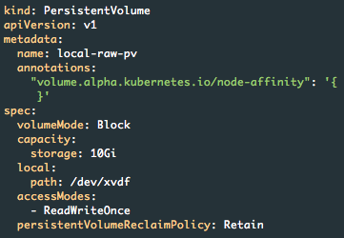
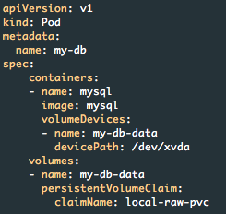
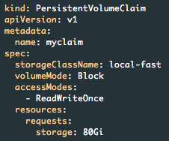
Kubernetes New Features - Block Device
Goal
provide container, including non-privileged container, with easy access to raw block device
Use case
Run distributed filesystem or database on top of kubernetes

Slide 63
Q&A
Thank you for your time

